Slide 1
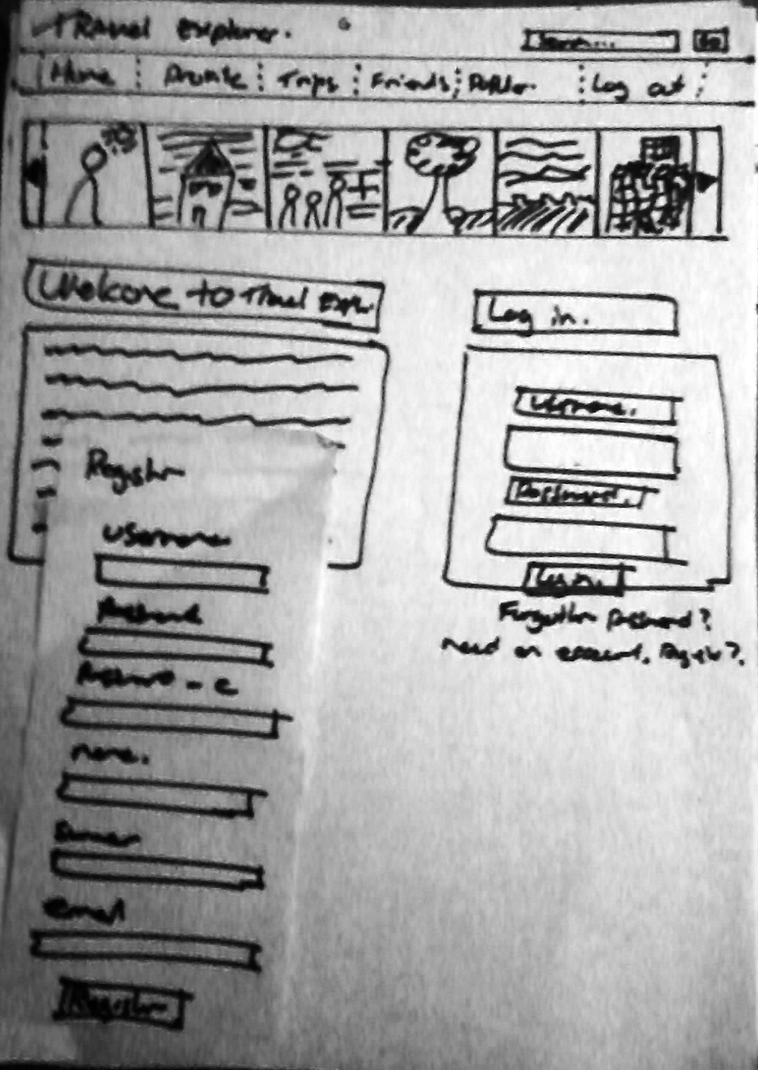
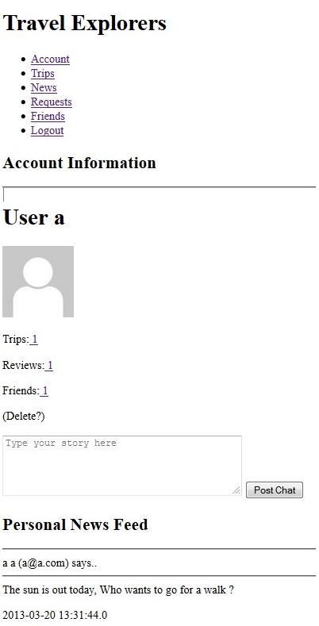
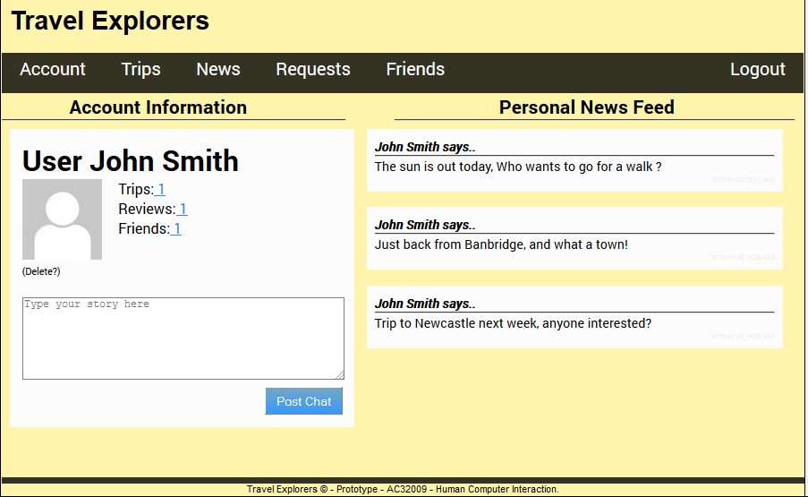

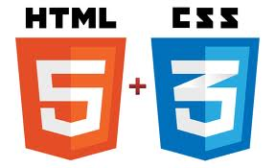


Travel Explorer
Group 1
Supervised by David Sloan
Travel Explorers is a website that fills a unique gap in the market between services that offer information on planning trips and services that allow you to book travel and accommodation associated with a trip.
Individuals can meet through shared interests and a desire to attend trips that may otherwise not be possible due to a lack of interested individuals.
Appealing to a demographic of people regardless of age “Travel Explorer” allows individuals to meet, plan, attend, and document trips through the use of social media. Communicating and sharing of ideas, hints, and tips with others creates a truly engaging experience for everyone.
Copy this text box for any sections of text you wish to use. Font is Book Antiqua 28 point.
“I don’t travel, so I’ll not be of much use!”
An initial response from a user who was of great assistance during an early focus group. Through further discussion it was found that this website would be ideal for helping individuals gain the opportunity to travel more with others.
The team used a user-centred design approach to designing the final solution. We began with a “focus group” of potential users to discover possible uses and features of the system. Our next step was to design a set of “paper prototypes” to test with users to ensure that the system was as accessible and easy-to-use .
Paper Prototype
HTML
Improved by CSS / JS
Initially we created a fully HTML version to ensure as many potential users as possible can access & use the website. Removing CSS or JS ensures that all browsers will support the website along with users who have slow connections. In the CSS and JS version we used black and yellow based on the research found from W3 as these colours improve readability for people with Dyslexia.

